Slide 1


The role of PD-First in growing access to dialysis in the context of universal healthcare coverage
Simon Davies

Slide 2
Scope
What is meant by PD-first? Definitions, Requirements, Pros and Cons
Hong Kong: The exemplar programme – what has it taught us?
  Role of government
  Health Economics
  Education
  Patient factors
Conclusions

Slide 3
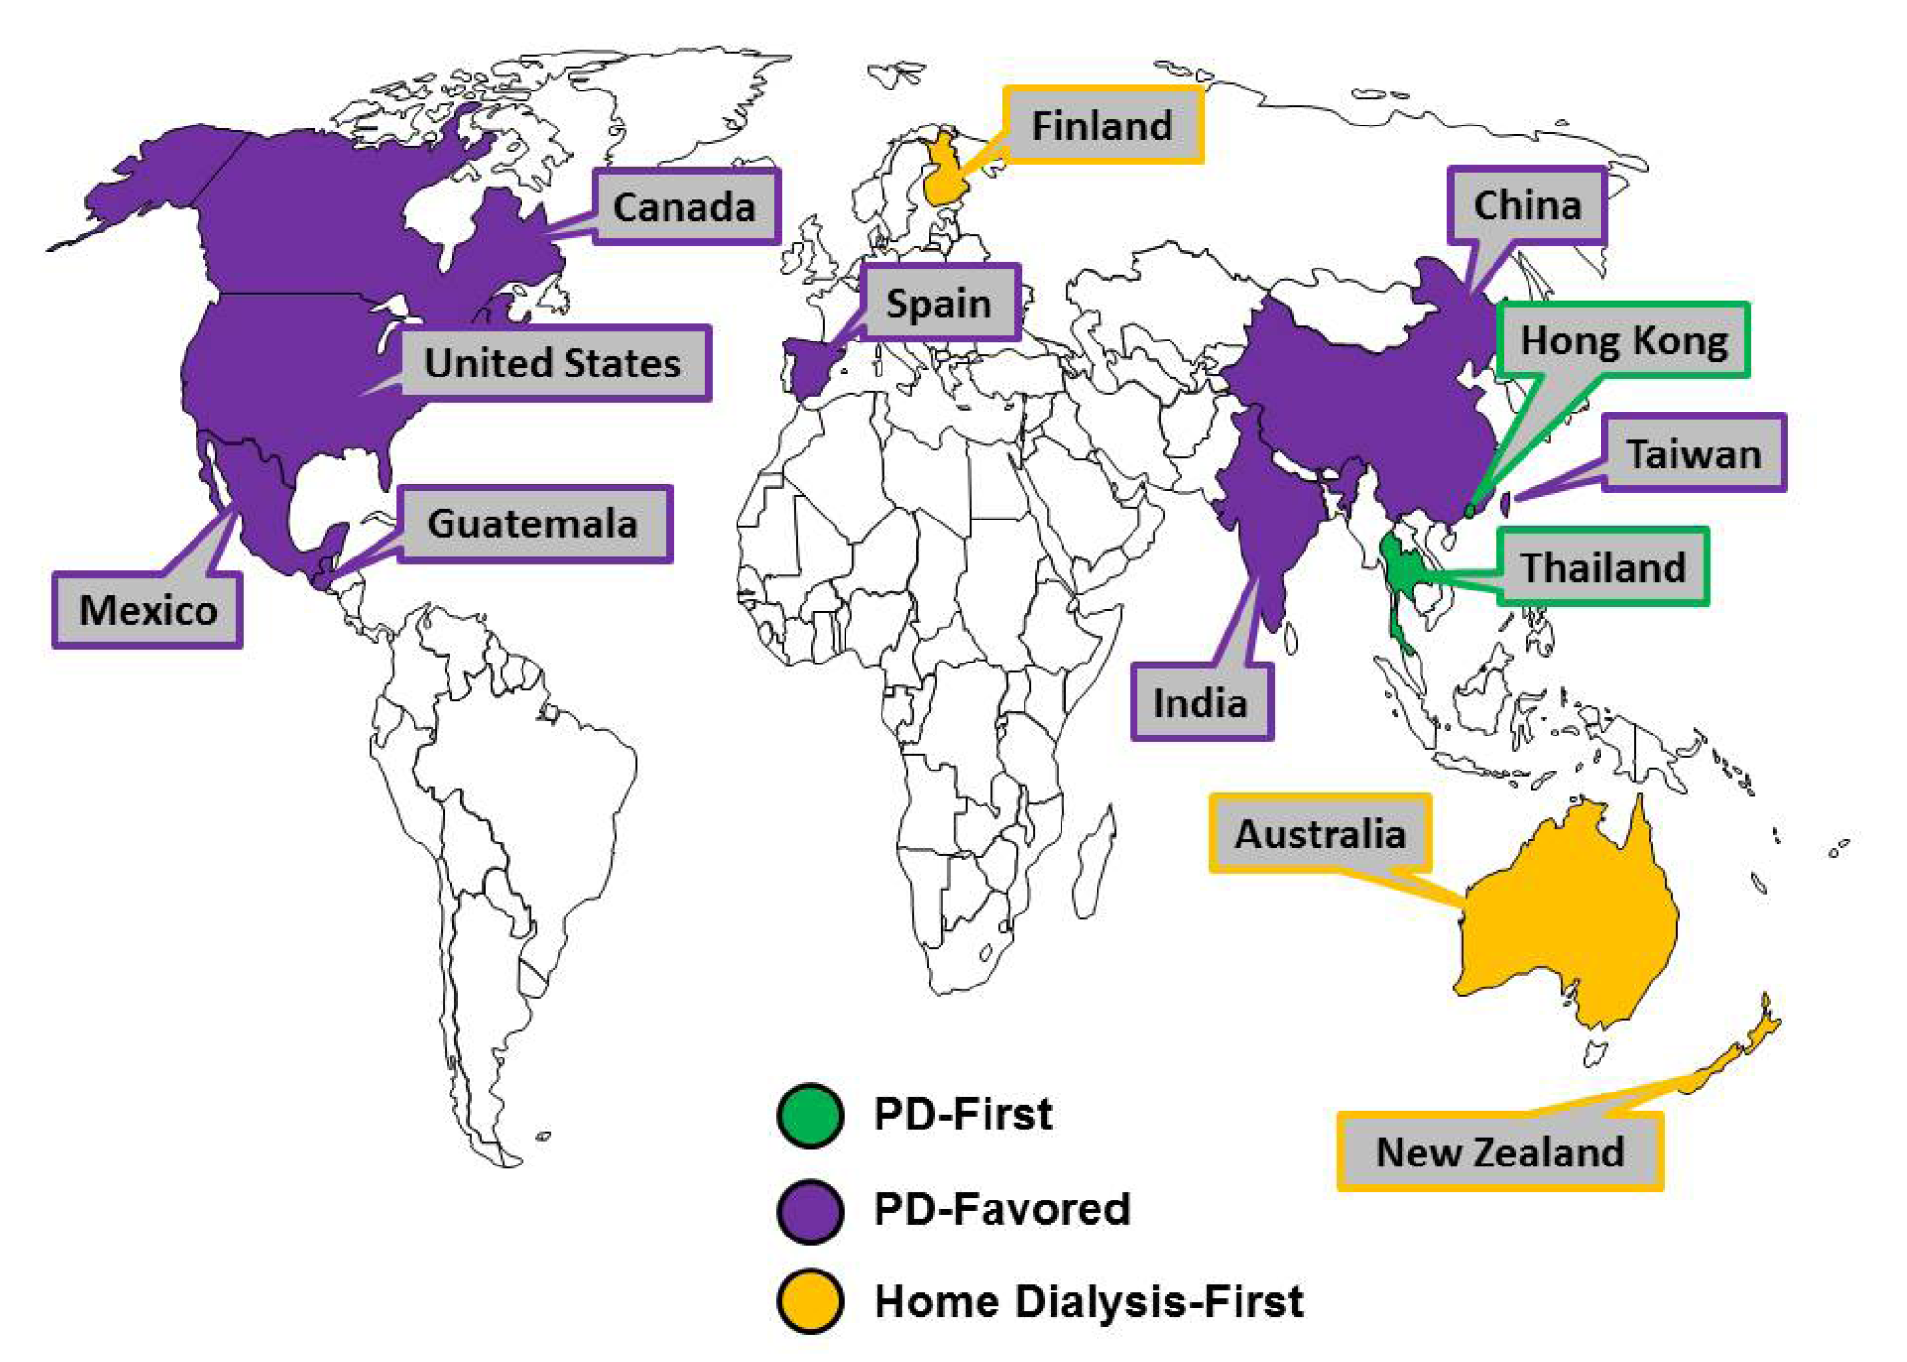
What is PD-first?
Usually defined as a policy in which:
‘Peritoneal Dialysis is made available to all as the first-line treatment for advanced kidney failure unless there is a medical contraindication’
It is distinguished from a PD-preferred or PD-favoured policy, in which the use PD is encouraged – typically by financial levers, but also by availability (e.g. rural settings, lack of water supply). In this context, for some countries it is part of a Home Dialysis – preferred policy
PDI, 2015;25,406-420

Slide 4
Pros and Cons for PD v. Centre-based HD
PROS
Cost-effectiveness – in many settings PD has been shown to be more cost effective than Centre-based haemodialysis.
  Equally – or more – effective (e.g., increased QUALY)
  Lower costs
  Less infrastructure investment
  Fewer Staff required
CONS
Often associated with higher “out of pocked payments”
Choice restriction
In many jurisdictions the cost of PD fluid is prohibitive
Better Incremental cost-effectiveness ratio (ICER)

Slide 5
Context, requirements and exceptions
Ideally a PD-first policy sits within a fully integrated kidney failure strategy
It should not be developed or used at the expense if transplantation where this is feasible – but is an excellent bridge to transplantation
Children are a special case – generally PD is a preferred treatment for children
A PD-first policy will always require sufficient back-up centre HD facilities – for those who are medically unsuitable wither initially or over time, and for temporary treatment

Slide 6
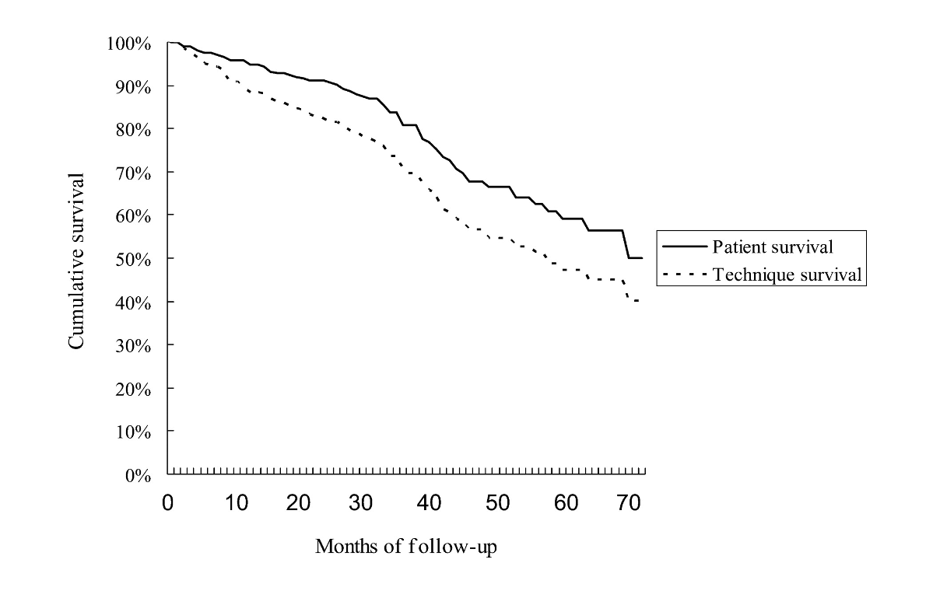
The Hong Kong PD-first policy
Established 1985 by the Central Renal Committee of the Medical and Health Department
Initially Continuous Ambulatory Peritoneal Dialysis (CAPD); later Automated PD (APD) and most recently Home Haemodialysis (HHD) were added.
Registry developed on parallel
Large centres with good success
in technique and patient survival

Slide 7
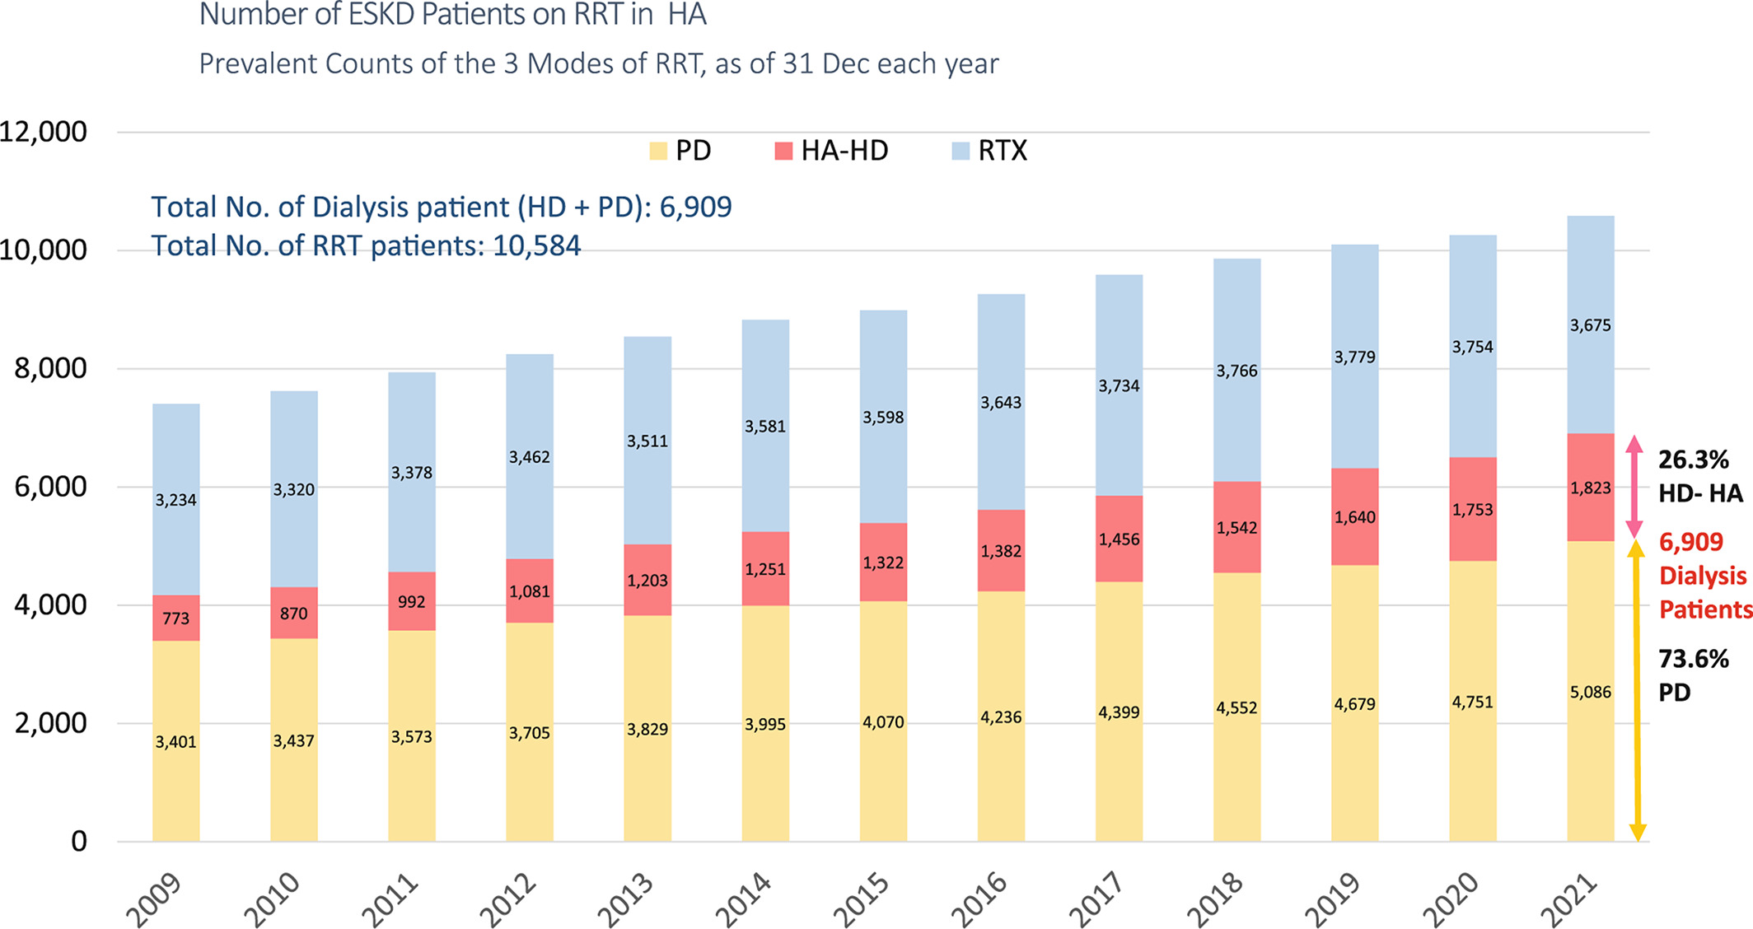
Peritoneal dialysis first policy in Hong Kong for 35 years
Nephrology, Volume: 27, Issue: 10, Pages: 787-794, First published: 08 April 2022, DOI: (10.1111/nep.14042)
Notes:
Number of end stage kidney disease (ESKD) patients on kidney replacement therapy (KRT) in Hospital Authority in Hong Kong as shown by the prevalent counts of the three modes of KRT‐Transplant, HD and PD as of 31 Dec each year. From 1996 to 2021, dialysis patients in HA increased 3.06 times from 2261 to 6909, with PD patients increasing from 1865 to 5086, a 2.73‐fold increase.Source: Data are from Hong Kong Renal Registry, Central Renal Committee, Hospital Authority
IF THIS IMAGE HAS BEEN PROVIDED BY OR IS OWNED BY A THIRD PARTY, AS INDICATED IN THE CAPTION LINE, THEN FURTHER PERMISSION MAY BE NEEDED BEFORE ANY FURTHER USE. PLEASE CONTACT WILEY'S PERMISSIONS DEPARTMENT ON PERMISSIONS@WILEY.COM OR USE THE RIGHTSLINK SERVICE BY CLICKING ON THE 'REQUEST PERMISSIONS' LINK ACCOMPANYING THIS ARTICLE. WILEY OR AUTHOR OWNED IMAGES MAY BE USED FOR NON-COMMERCIAL PURPOSES, SUBJECT TO PROPER CITATION OF THE ARTICLE, AUTHOR, AND PUBLISHER.

Slide 8
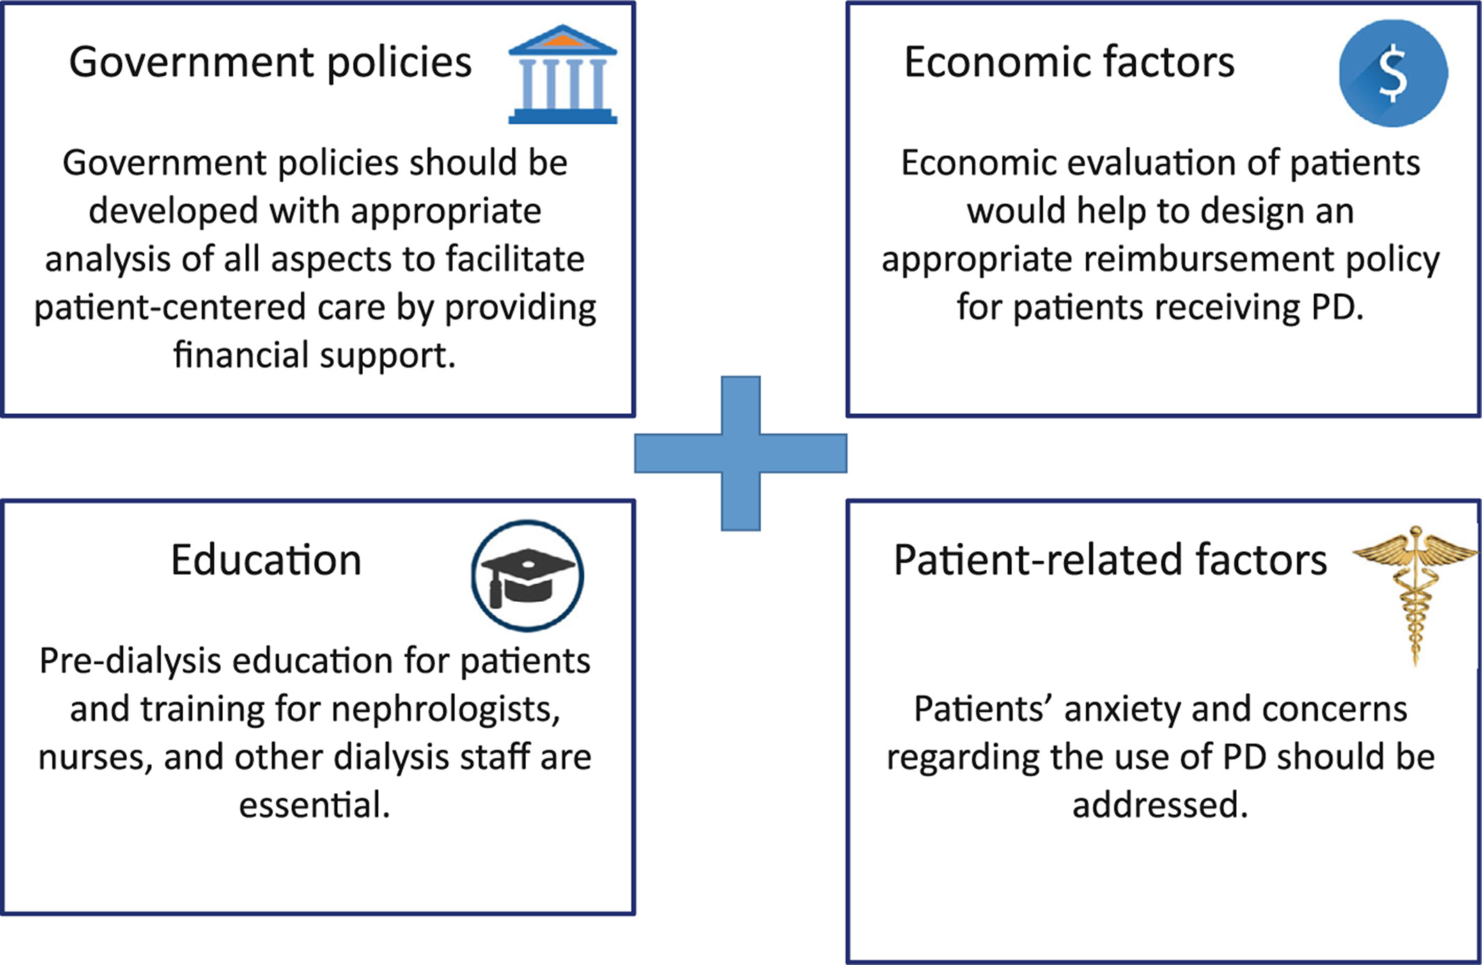
What did we learn from the Kong Kong PD-first programme?
Nephrology, Volume: 27, Issue: 10, Pages: 787-794, First published: 08 April 2022, DOI: (10.1111/nep.14042)
Notes:
Learnings from Hong Kong's PD‐first Policy
IF THIS IMAGE HAS BEEN PROVIDED BY OR IS OWNED BY A THIRD PARTY, AS INDICATED IN THE CAPTION LINE, THEN FURTHER PERMISSION MAY BE NEEDED BEFORE ANY FURTHER USE. PLEASE CONTACT WILEY'S PERMISSIONS DEPARTMENT ON PERMISSIONS@WILEY.COM OR USE THE RIGHTSLINK SERVICE BY CLICKING ON THE 'REQUEST PERMISSIONS' LINK ACCOMPANYING THIS ARTICLE. WILEY OR AUTHOR OWNED IMAGES MAY BE USED FOR NON-COMMERCIAL PURPOSES, SUBJECT TO PROPER CITATION OF THE ARTICLE, AUTHOR, AND PUBLISHER.

Slide 9

Government Policy
Commitment to comprehensive/universal healthcare coverage
Trade of with competing requirements for health expenditure
Requires an understanding the problem of catastrophic healthcare expenditure
Re-imbursement policy – fundamental
Facilitate availability of PD fluid at an affordable cost
Strategy for both urban and rural settings

Slide 10

Health Economic Evaluation
Requires health economic modelling that considers –
Comparative treatment strategies
  Centre haemodialysis provision
  Transplantation (if available)
  Conservative/supportive/palliative care
Treatment costs and societal costs
Out of pocket expenses
Opportunity costs
Intervention horizon

Slide 11
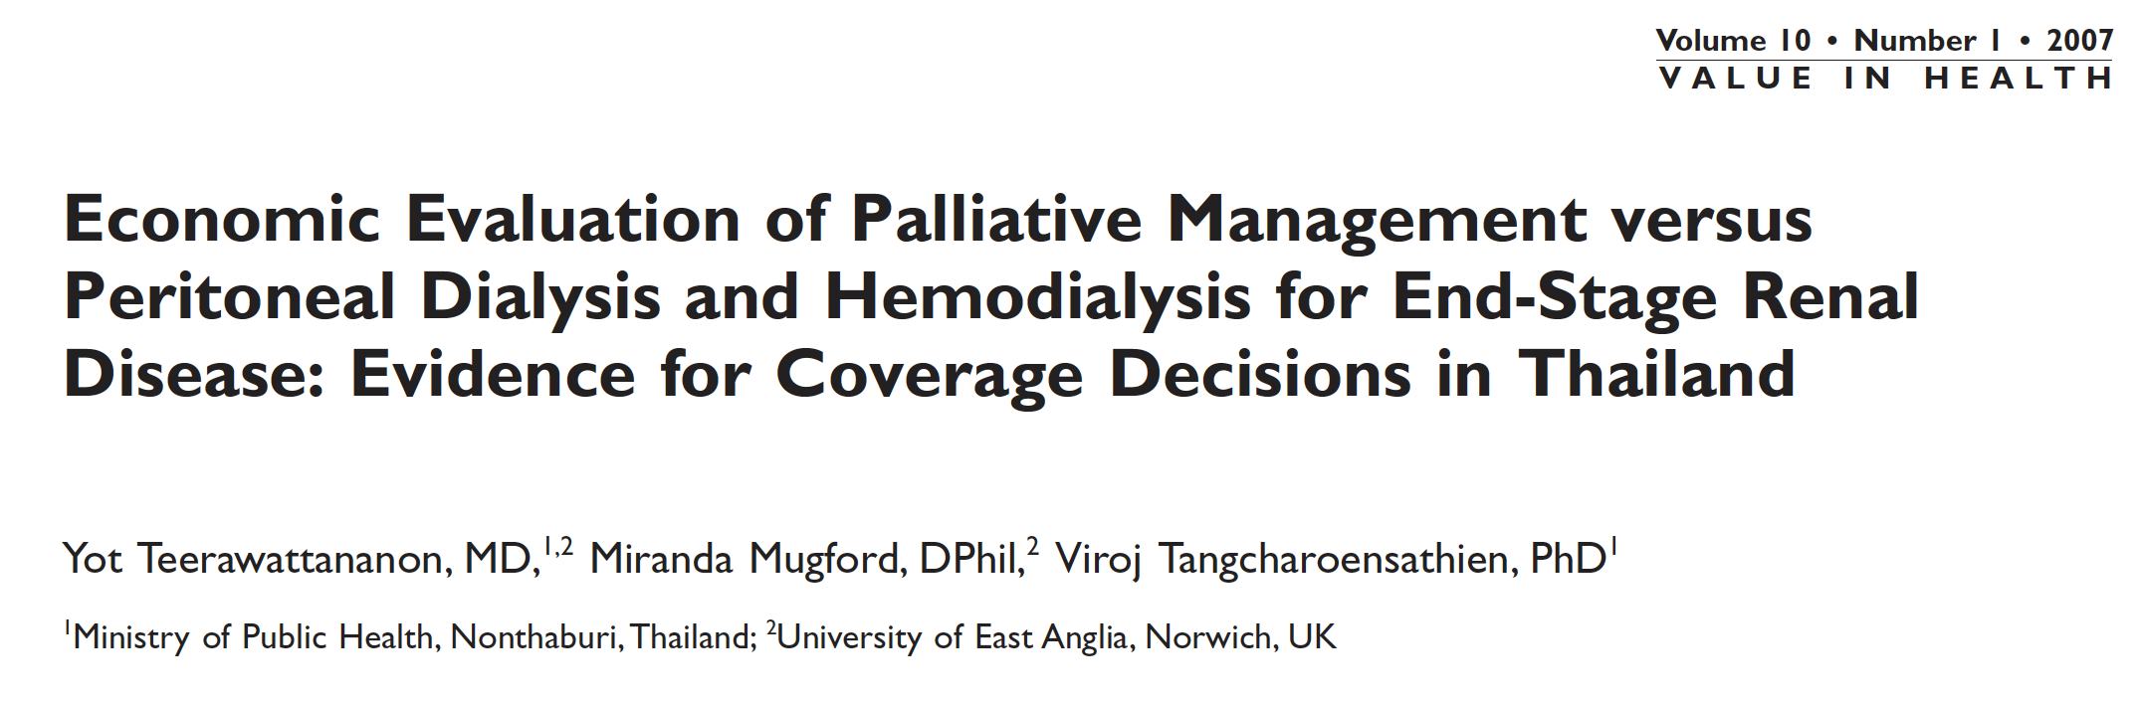
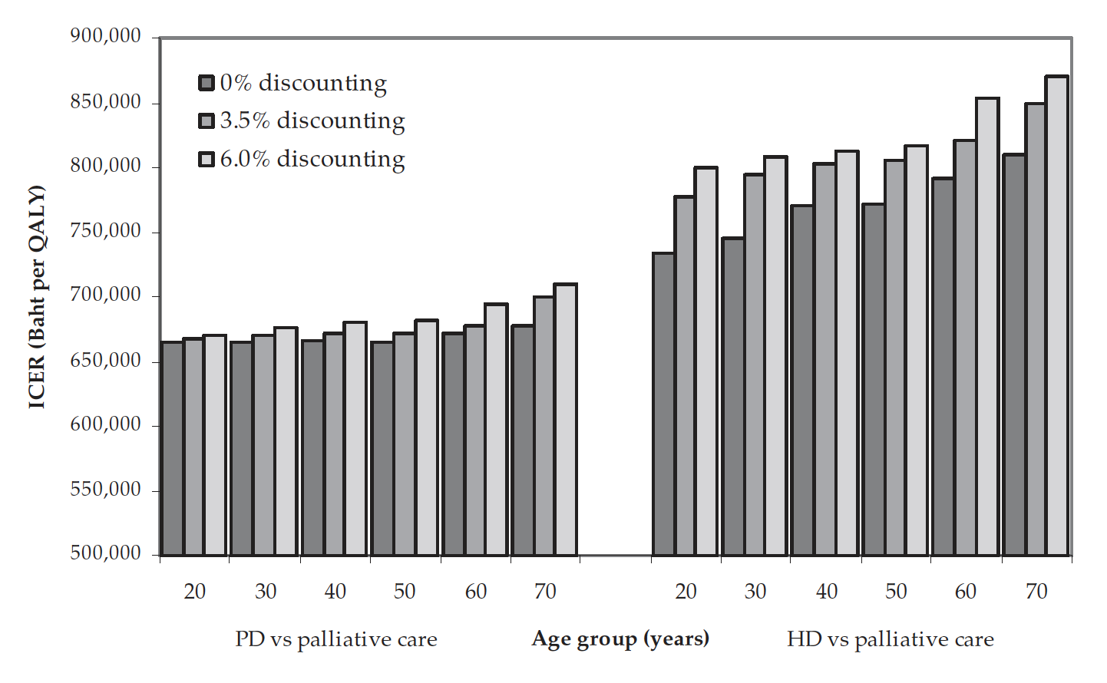

Slide 12
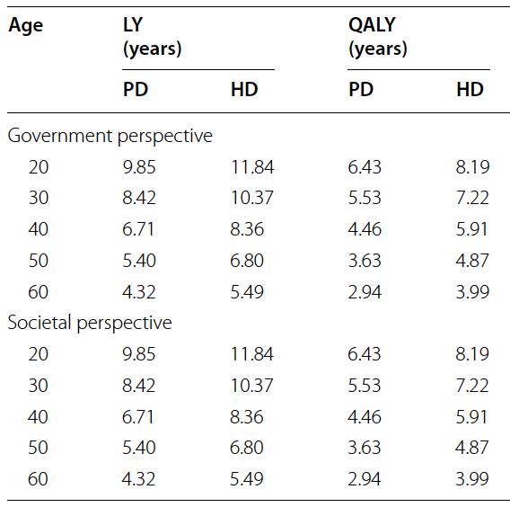
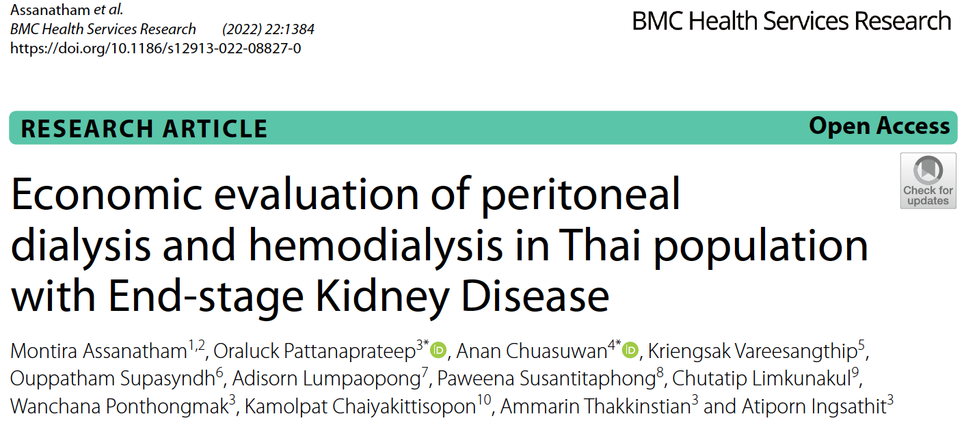
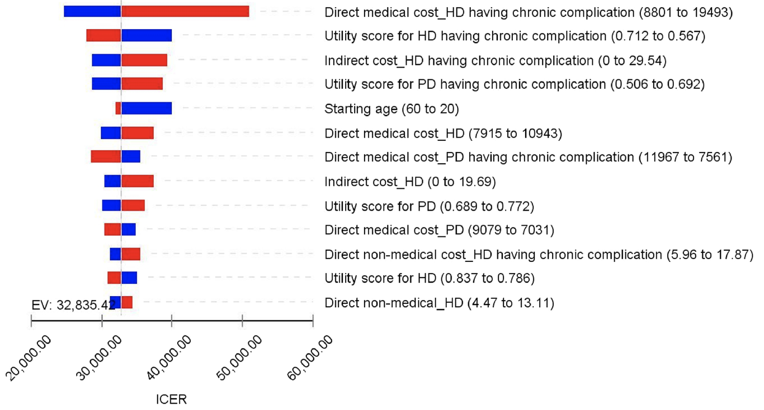
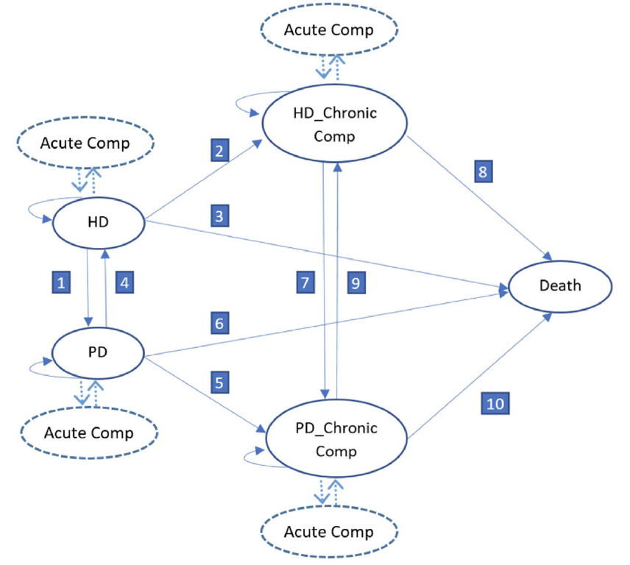

Slide 13
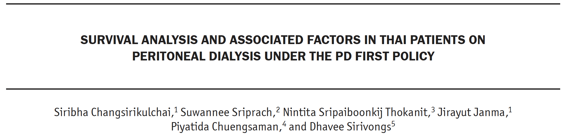
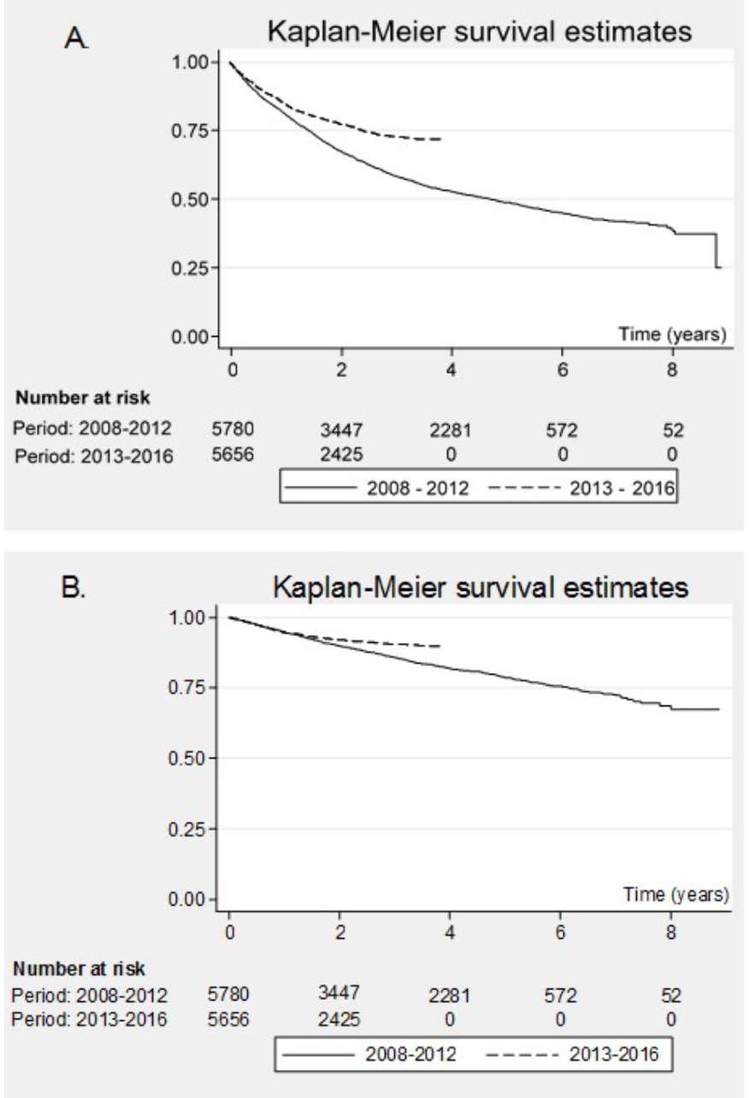
11,477 people treated with PD registered with DPEX (35%)
Improved outcomes for 2013-16, versus 2008-2012
PD almost exclusively used by Universal Health Coverage scheme (>90%)
Those insured by the civil servant scheme (+ family) use HD and (unpublished) comparisons of HD v PD
Adjusted survival least good for UHC scheme (HR 1.13, CI 1.07-1.2 in-hospital death) BMC HSR 2016
Risk is that modality outcomes are conflated with insurance scheme

Slide 14
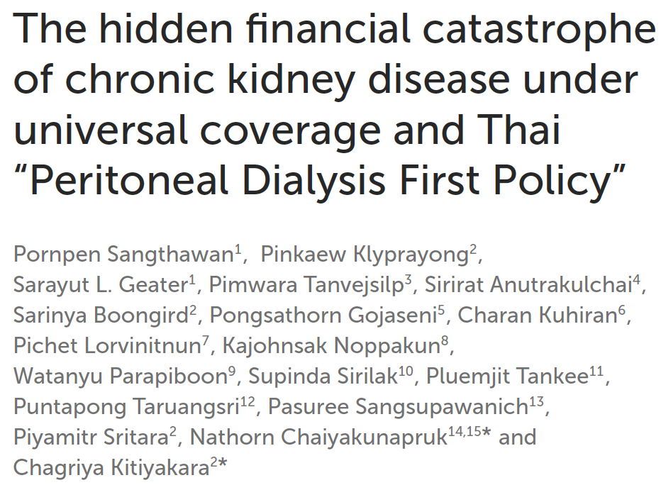
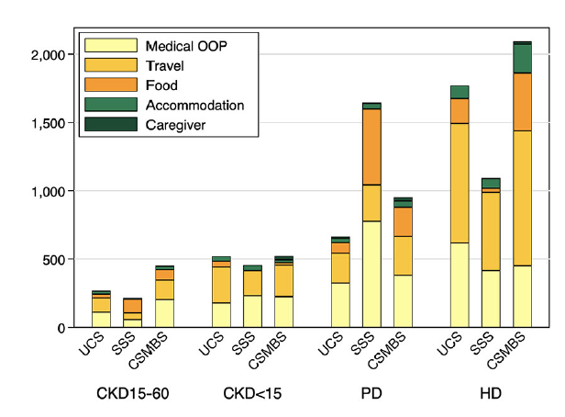
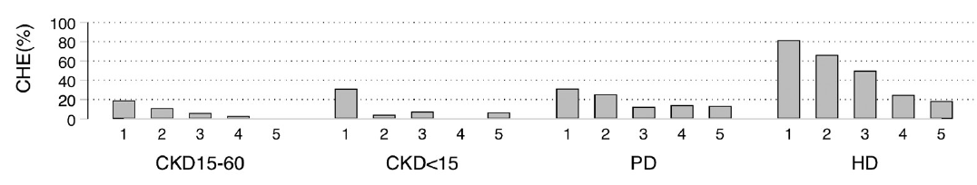
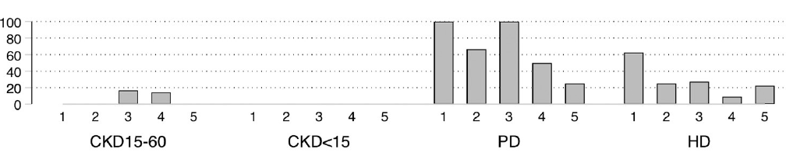
Catastrophic Healthcare Expenditure
UCS: Universal Coverage Scheme
SSS: Social Security Scheme

Slide 15
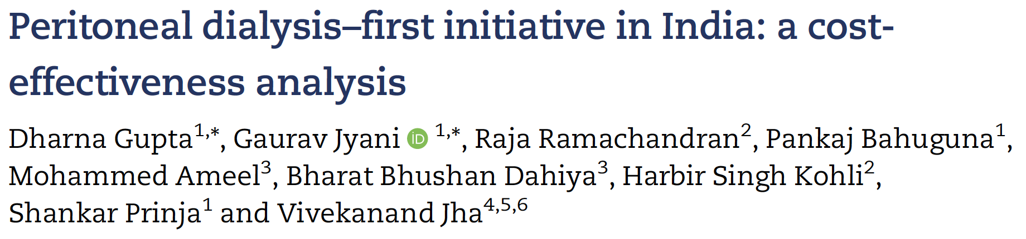
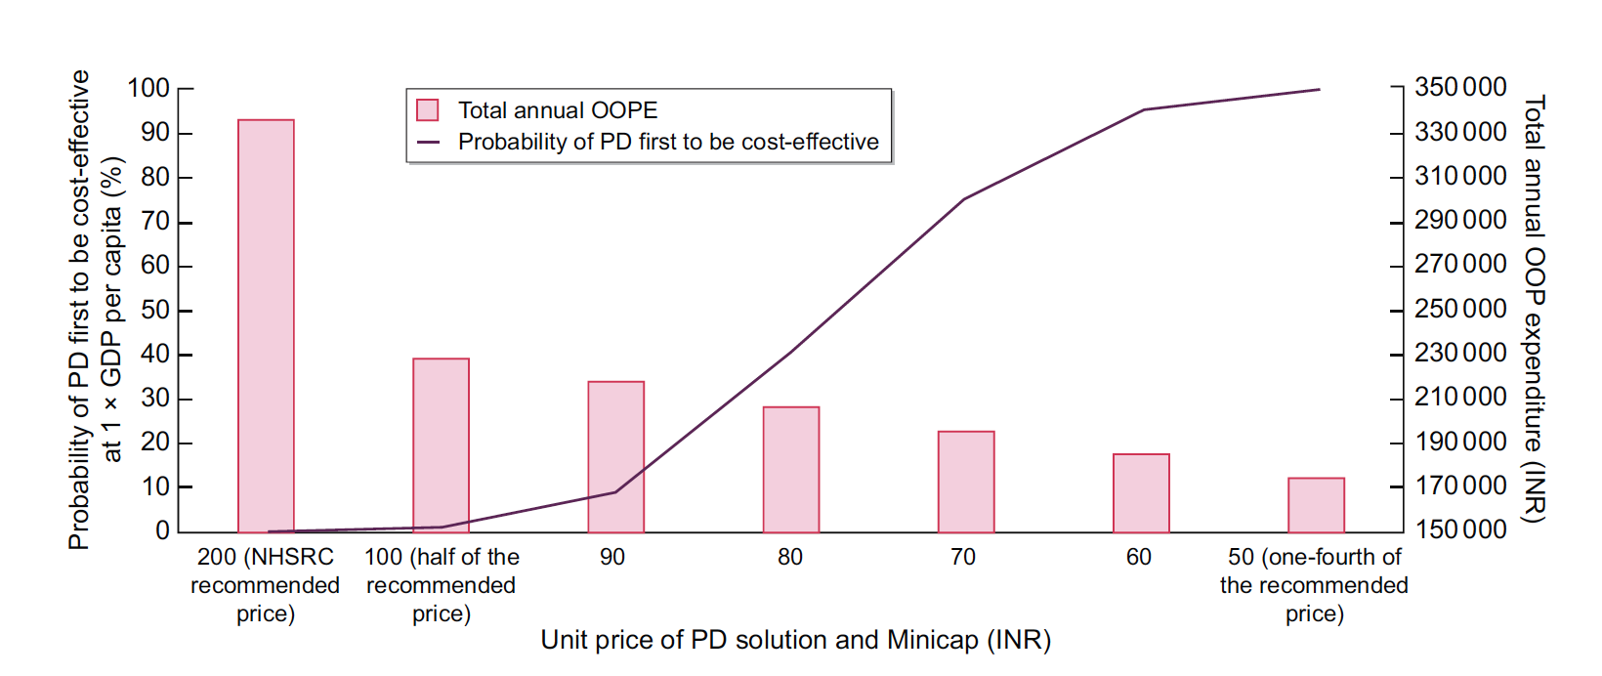

Slide 16
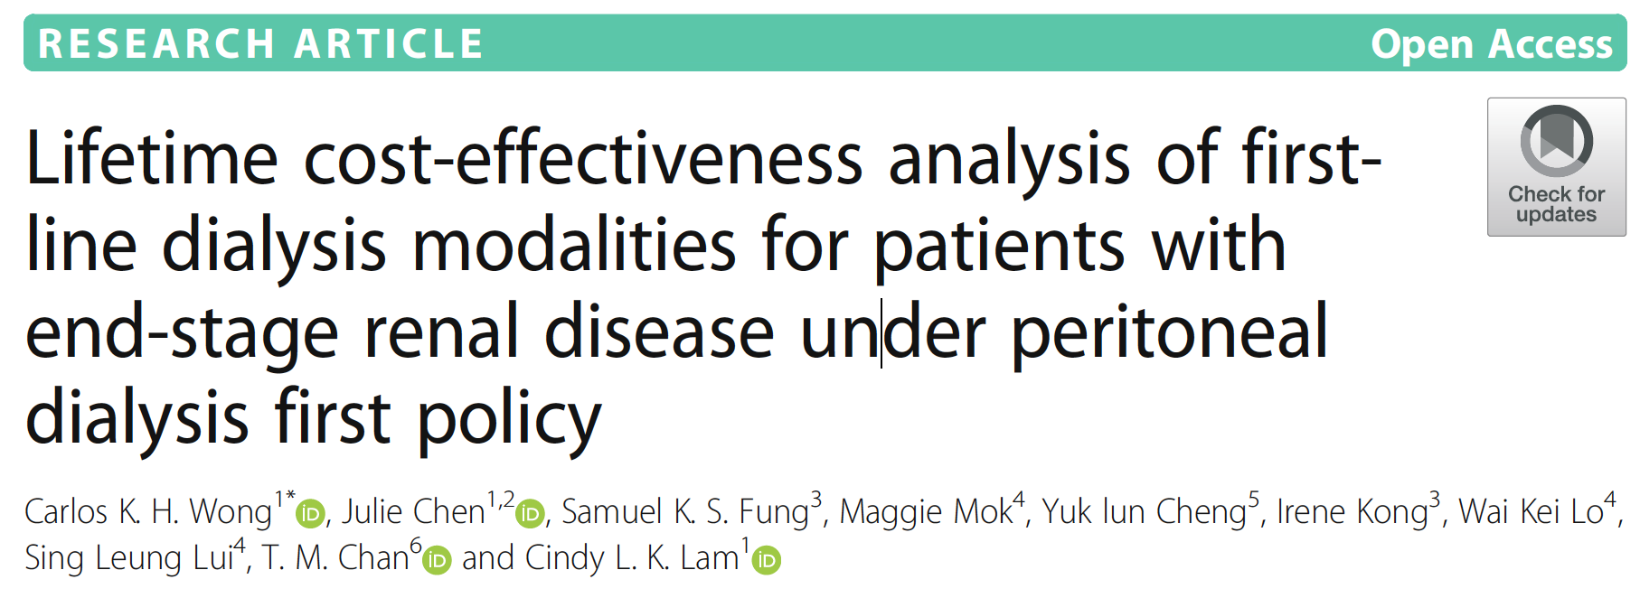
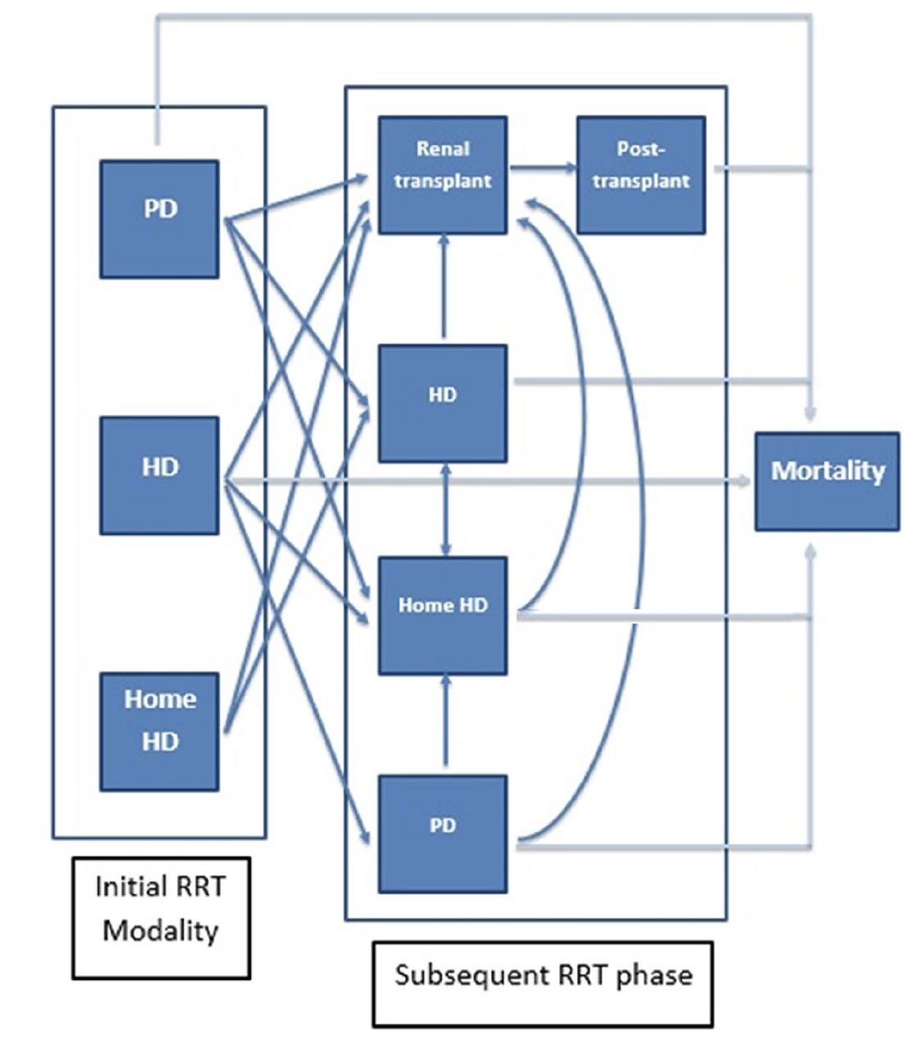
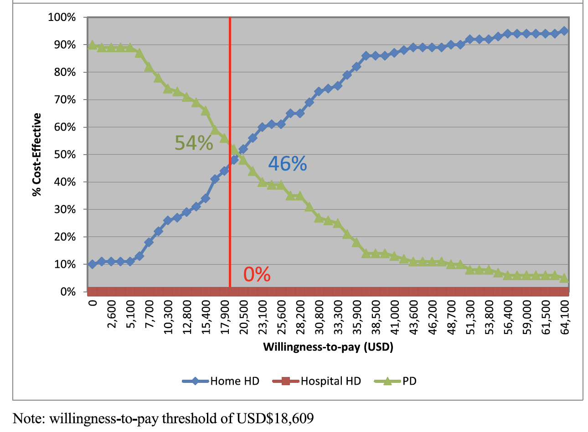

Slide 17

Education
All groups need educating: providers, healthcare professionals, patients, their families and carers
Establishing dedicated pre-dialysis clinics
Invite providers to visit programmes
Use trained – ‘non’-nephrologists to tackle work force shortages (Mexico, Thailand)
Exemplar ‘expert’ units
Patient groups
Text-books in local language

Slide 18
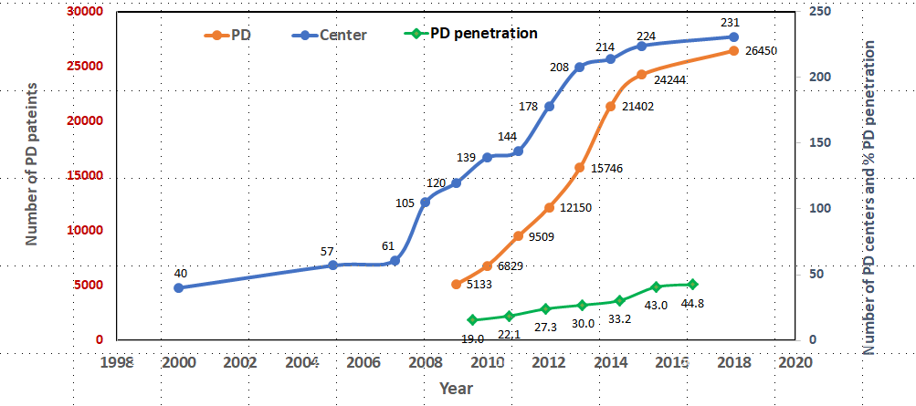
Thailand PD numbers, centers & penetration
PD First Policy
Kanjanabuch T, Kidney360 2020

Slide 19

Hazard ratios of PD Discontinuation by Country
Hazard Ratio (95% CI)
Japan
US
Thailand
Canada
UK
A/NZ
Hazard ratio was estimated using cox model, accounting for left-truncation arising from some patients initiating dialysis prior to study enrollment. Model adjusted for patient age, gender, and diabetes.

Slide 20

Patient factors
PD has a number of drawbacks and causes for concern
  Some will be disinterested in doing a home therapy – and will resist it.
    Unwilling to take responsibility
    Burn-out
    Burden of care – also for relatives
    Lack of confidence, made worse by lack of trust in their medical team
    Concern over PD-related complications
Lack of choice
  Restricted choice, when the choice effects day-to-day life so much is an important issues
  The patient voice is strong – Thailand has now now discontinued a PD-first policy for this reason

Slide 21
Summary
PD-first is a policy that can facilitate the introduction of universal healthcare coverage for dialysis
It can be associated with better cost-effectiveness than in-centre dialysis, provided that the cost of PD fluids is negotiated
It can relieve catastrophic healthcare expenditure and reduce out of pocked expenditure
Outcomes can be excellent, but also less good – but it is important not to conflate outcomes with health insurance system
It does restrict patient choice – and this may lead to discontent and a requirement to modify the policy

Slide 22
References
Peritoneal dialysis first policy in Hong Kong for 35 years: Global impact. Li, P. K-T. et al, Nephrology. 2022;27:787–794. https://doi.org/10.1111/nep.14042
A global overview of the impact of peritoneal dialysis first or favored policies: an opinion Liu, F.X. et al, Peritoneal Dialysis International, Vol. 35, pp. 406–420 https://doi.org/10.3747/pdi.2013.00204
Economic Evaluation of Palliative Management versus Peritoneal Dialysis and Hemodialysis for End-Stage Renal Disease: Evidence for Coverage Decisions in Thailand; Teerawattananon, Y et al. Value in Heath, 2007;10:61-71 https://doi.org/10.1111/j.1524-4733.2006.00145.x.
Economic evaluation of peritoneal dialysis and hemodialysis in Thai population with End‑stage Kidney Disease. Assanatham et al. BMC Health Services Research (2022) 22:1384 https://doi.org/10.1186/s12913-022-08827-0
Peritoneal dialysis–first initiative in India: a cost-effectiveness analysis Clinical Kidney Journal, 2022;15:128-135 https://doi.org/10.1093/ckj/sfab126
Lifetime cost-effectiveness analysis of first-line dialysis modalities for patients with end-stage renal disease under peritoneal dialysis first policy. Wong et al. BMC Nephrology (2020) 21:42 https://doi.org/10.1186/s12882-020-1708-0

